Slide 1
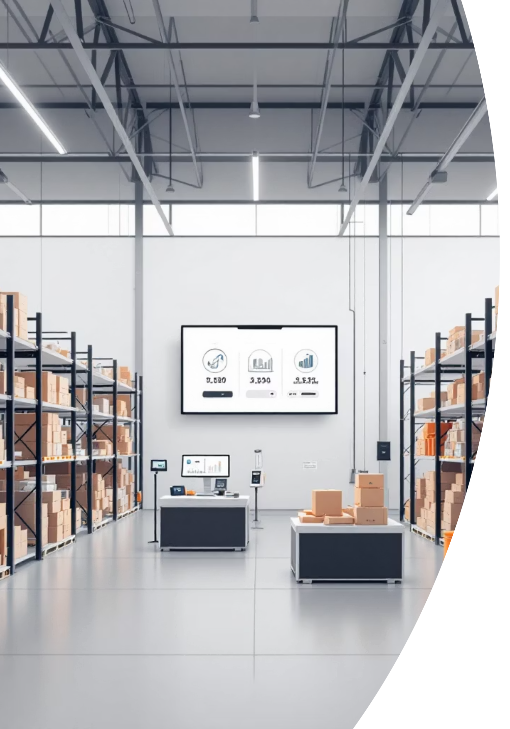
Inventory Monitoring and Reporting System
A comprehensive web-based solution for efficient stock management and real-time tracking
Presented by: M Rekha | Batch-13 | Infosys Springboard

Slide 2
Table of Contents
01
02
Introduction
Technology Stack
Project overview and core concepts
Frontend, backend, and database technologies
03
04
System Architecture
Module Explanation
System design and component structure
Key system modules and functionalities
05
06
Key Features
Advantages
Core capabilities and benefits
Benefits over traditional methods
07
08
Challenges & Future
Conclusion
Current limitations and enhancements
Summary and final insights

Slide 3

Problem Statement
The Current Challenge
Many small and medium businesses continue to rely on manual registers or spreadsheets for inventory tracking, creating operational bottlenecks.
Key Issues Include:
Data inconsistency across multiple sources
Stock mismanagement and tracking errors
Time-consuming record updates
Delayed product information retrieval
Increased human error probability
A smart, automated inventory system is essential for modern business operations.

Slide 4
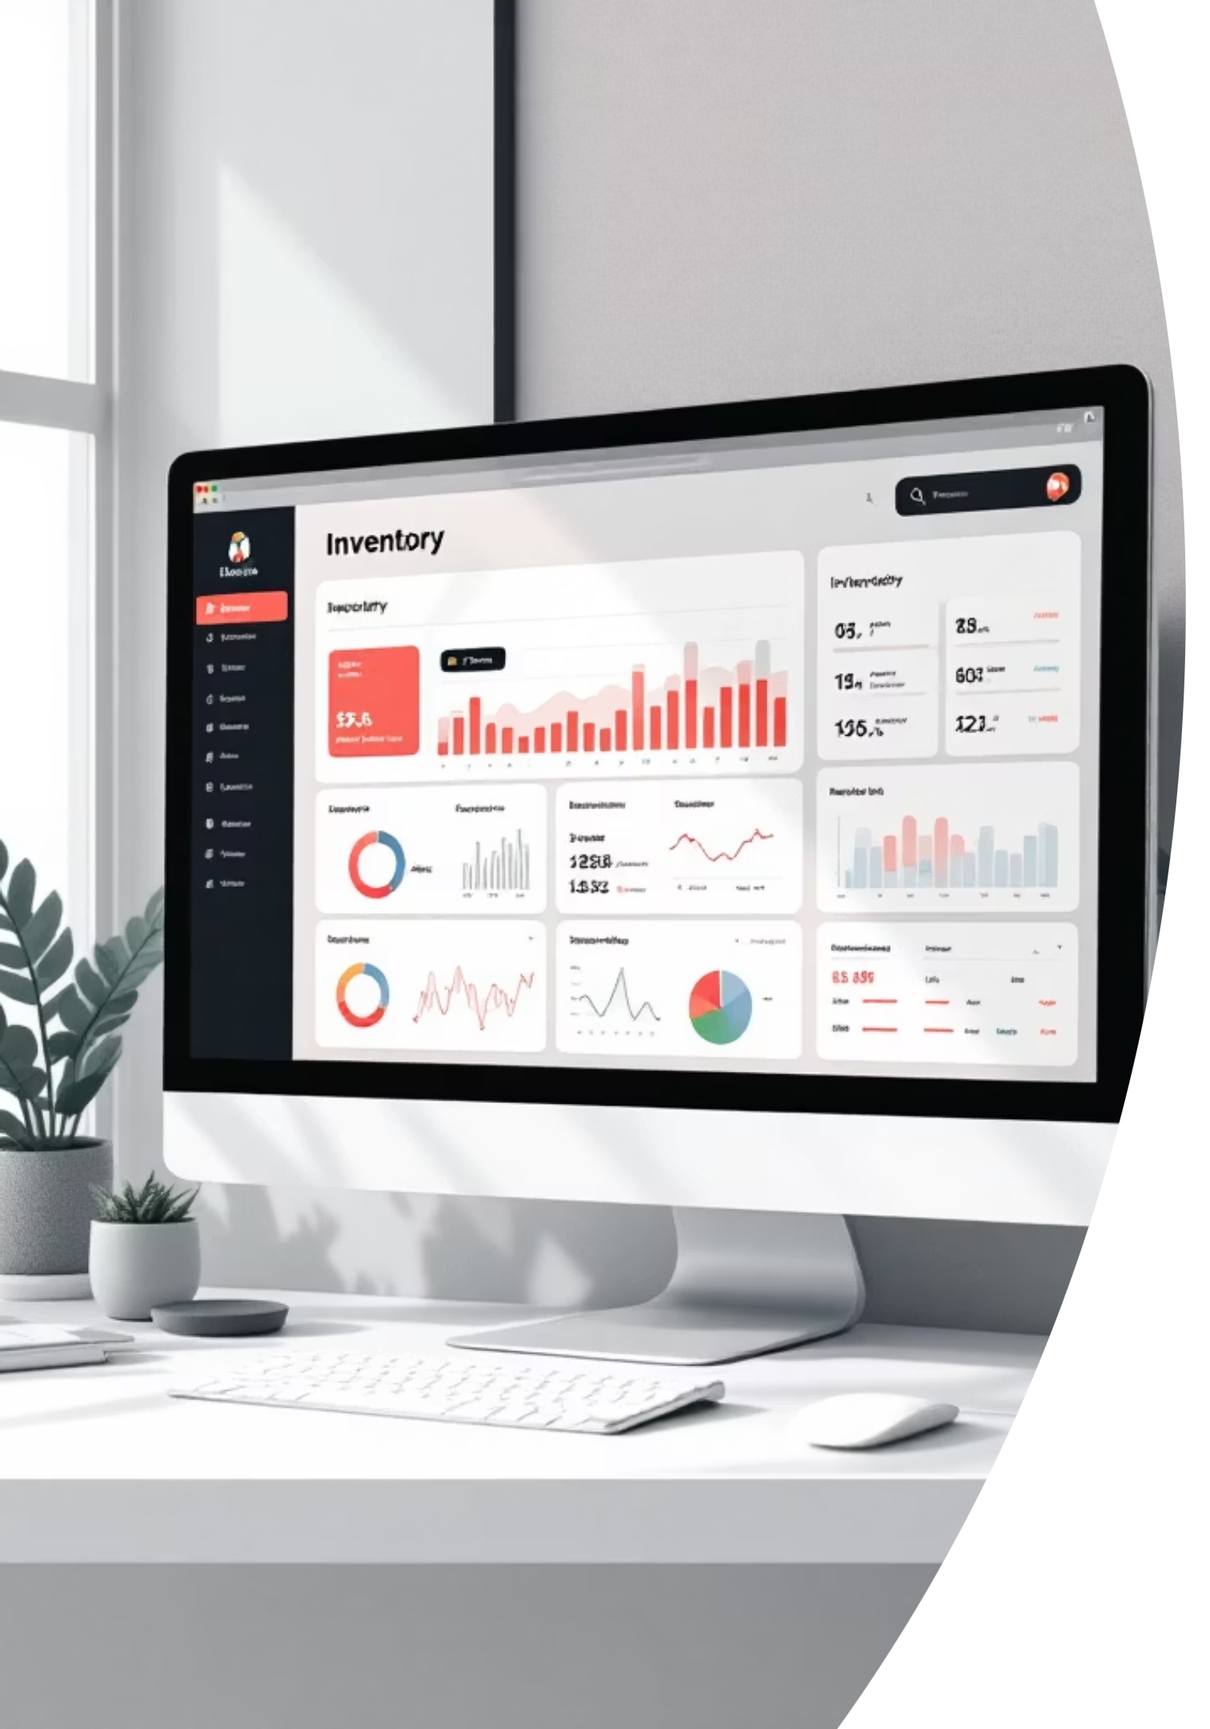

Introduction
Essential Process
Traditional Limitations
Inventory management is a critical business function for tracking, controlling, and organizing goods efficiently across all operations.
Conventional inventory handling methods are time-consuming, error-prone, and difficult to scale as business grows.
Digital Solution
This project delivers a modern web-based system for managing stock, storage, and product movement digitally.

Slide 5
Main Project Objectives
This inventory system was designed with specific goals to address business needs:
1
User-Friendly Interface
Develop an intuitive, accessible system that requires minimal training for warehouse staff and managers.
2
Automation
Automate storage operations and stock handling processes to reduce manual intervention and errors.
3
Data Accuracy
Ensure accurate record maintenance through validated data entry and automatic quantity tracking.
4
Quick Access
Provide instant access to inventory data with search and filtering capabilities for faster decision-making.
5
Real-Time Updates
Improve business decisions through live inventory updates and instant stock availability visibility.

Slide 6




Project Scope
Target Applications
This system serves multiple business environments:
Warehouses and distribution centers
Retail shops and stores
Small and medium industries
Storage management units
Educational purposes for full-stack development learning
Product Entry
Stock Updates
Report Generation
Add new inventory items with complete details
Real-time quantity tracking and modifications
Comprehensive inventory reports and analytics

Slide 7
Technologies Used
A modern full-stack architecture combining proven technologies for reliability and performance:
Frontend Stack
Backend Stack
React JS for dynamic UI
HTML & CSS for structure
JavaScript for interactivity
Axios for API calls
Java programming language
Spring Framework ecosystem
Spring Boot for rapid development
Spring Data JPA for data access
REST API for communication
Database
Development Tools
MySQL for data storage
Structured query language
Relational data model
IntelliJ IDEA for coding
Postman for API testing
Git & GitHub for version control

Slide 8

Existing System Analysis
Current Manual Approach
Traditional inventory systems rely on paper-based records and spreadsheet files, creating multiple operational challenges:
Result: Less efficient, error-prone operations
Manual Record Maintenance
Physical registers and Excel files require hand-written entries
Slow Stock Updates
Time-consuming process to update inventory quantities
Difficult Reporting
Generating reports requires manual data compilation
Duplicate Entry Risk
High probability of data entry errors and duplicates
Availability Monitoring
Challenging to track product availability in real-time

Slide 9

Proposed System Solution
A web-based application that addresses existing system limitations through digital automation:
Digital Data Storage
CRUD Operations
Real-Time Tracking
Centralized database stores all inventory information securely and eliminates paper-based records
Users can create, read, update, and delete product records with simple interface actions
Stock quantities update instantly with every transaction, providing live inventory visibility
Storage Management
Secure Access
Efficient organization and tracking of storage locations and product placements
Protected login system with role-based access control ensures data security
Outcome: Enhanced performance, accuracy, and productivity through digital transformation

Slide 10
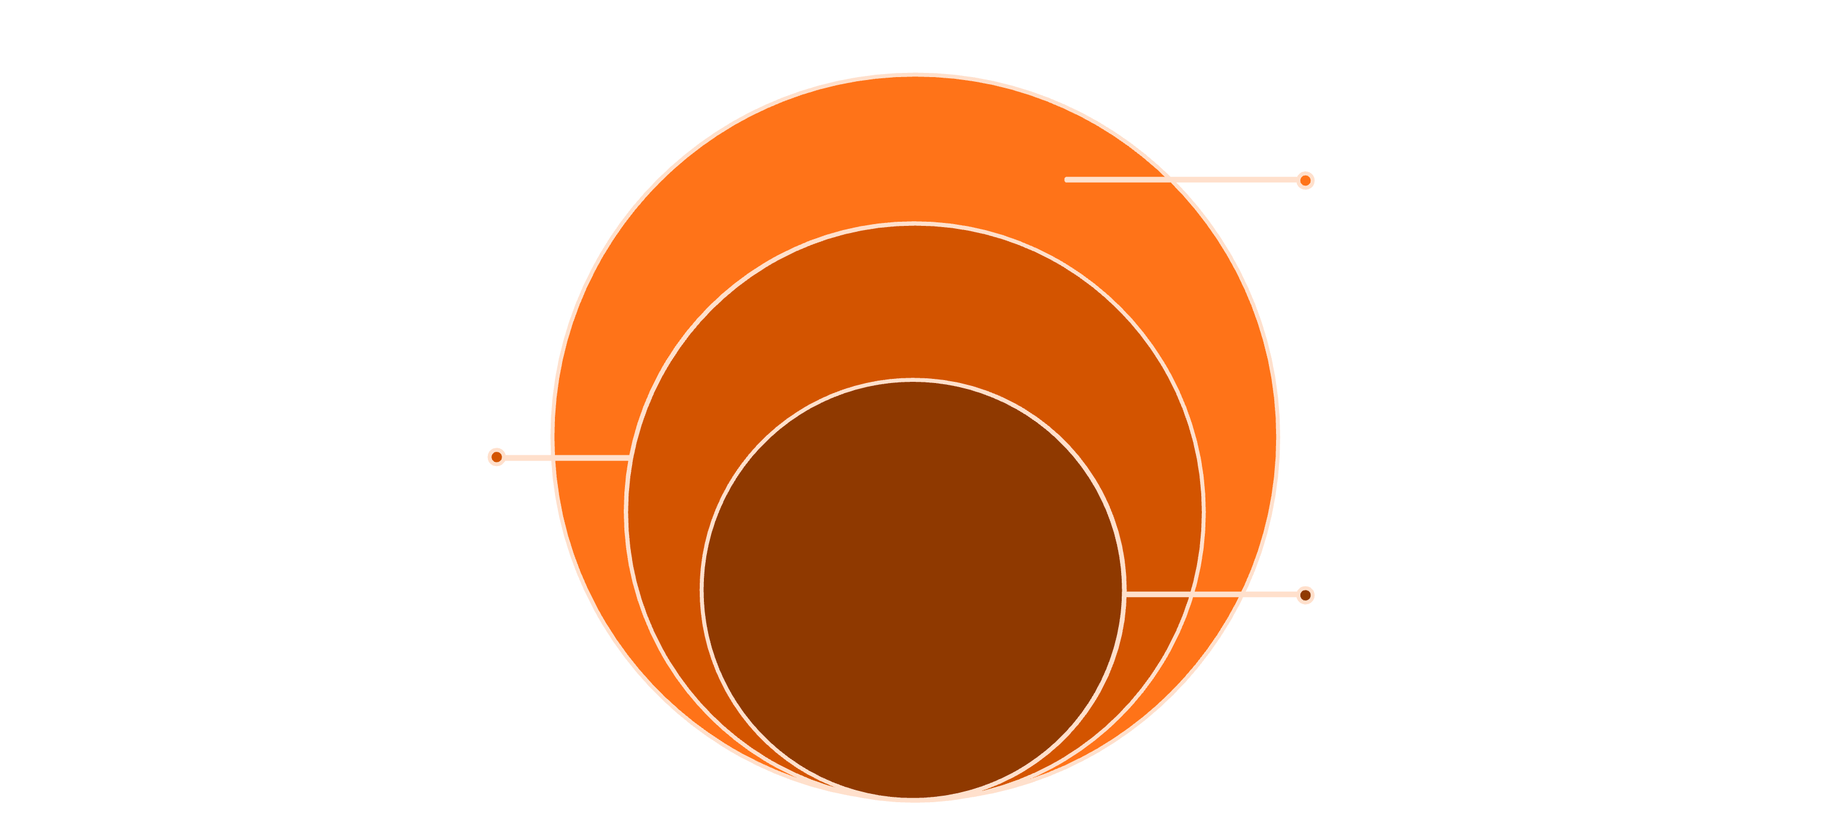
System Architecture
A layered architecture ensuring separation of concerns and maintainable code structure:
Data Layer
MySQL database storing persistent data
Application Layer
Spring Boot REST API for business logic
Client Layer
React frontend handling UI and interactions

Slide 11

Why React for Frontend
Reusable Components
Build UI elements once and reuse them throughout your application, saving development time and ensuring consistency
Fast Rendering
Virtual DOM technology ensures lightning-fast updates and smooth user interactions without full page reloads
Single-Page Experience
Create seamless, app-like experiences that respond instantly to user actions
Structured Development
Component-based architecture makes frontend code organized, maintainable, and easy to scale

Slide 12
Why Spring Boot for Backend
Simplified Development
RESTful Services
Auto-configuration and convention-over-configuration reduce boilerplate code, letting developers focus on business logic
Built-in support for creating REST APIs with minimal configuration and maximum flexibility
Dependency Injection
Security & Scalability
Spring's powerful DI container manages component dependencies automatically, promoting loose coupling and testability
Enterprise-grade security features and seamless database integration create robust, production-ready applications

Slide 13
Modules of the System
A comprehensive inventory management solution organized into specialized modules, each handling specific operational tasks
1
2
User Authentication
Product Management
Secure login and access control
Central catalog of all inventory items
3
4
Stock Management
Storage Management
Real-time inventory tracking
Warehouse organization and location tracking
5
6
Supplier/Category
Reporting
Vendor and classification system
Data analytics and insights

Slide 14
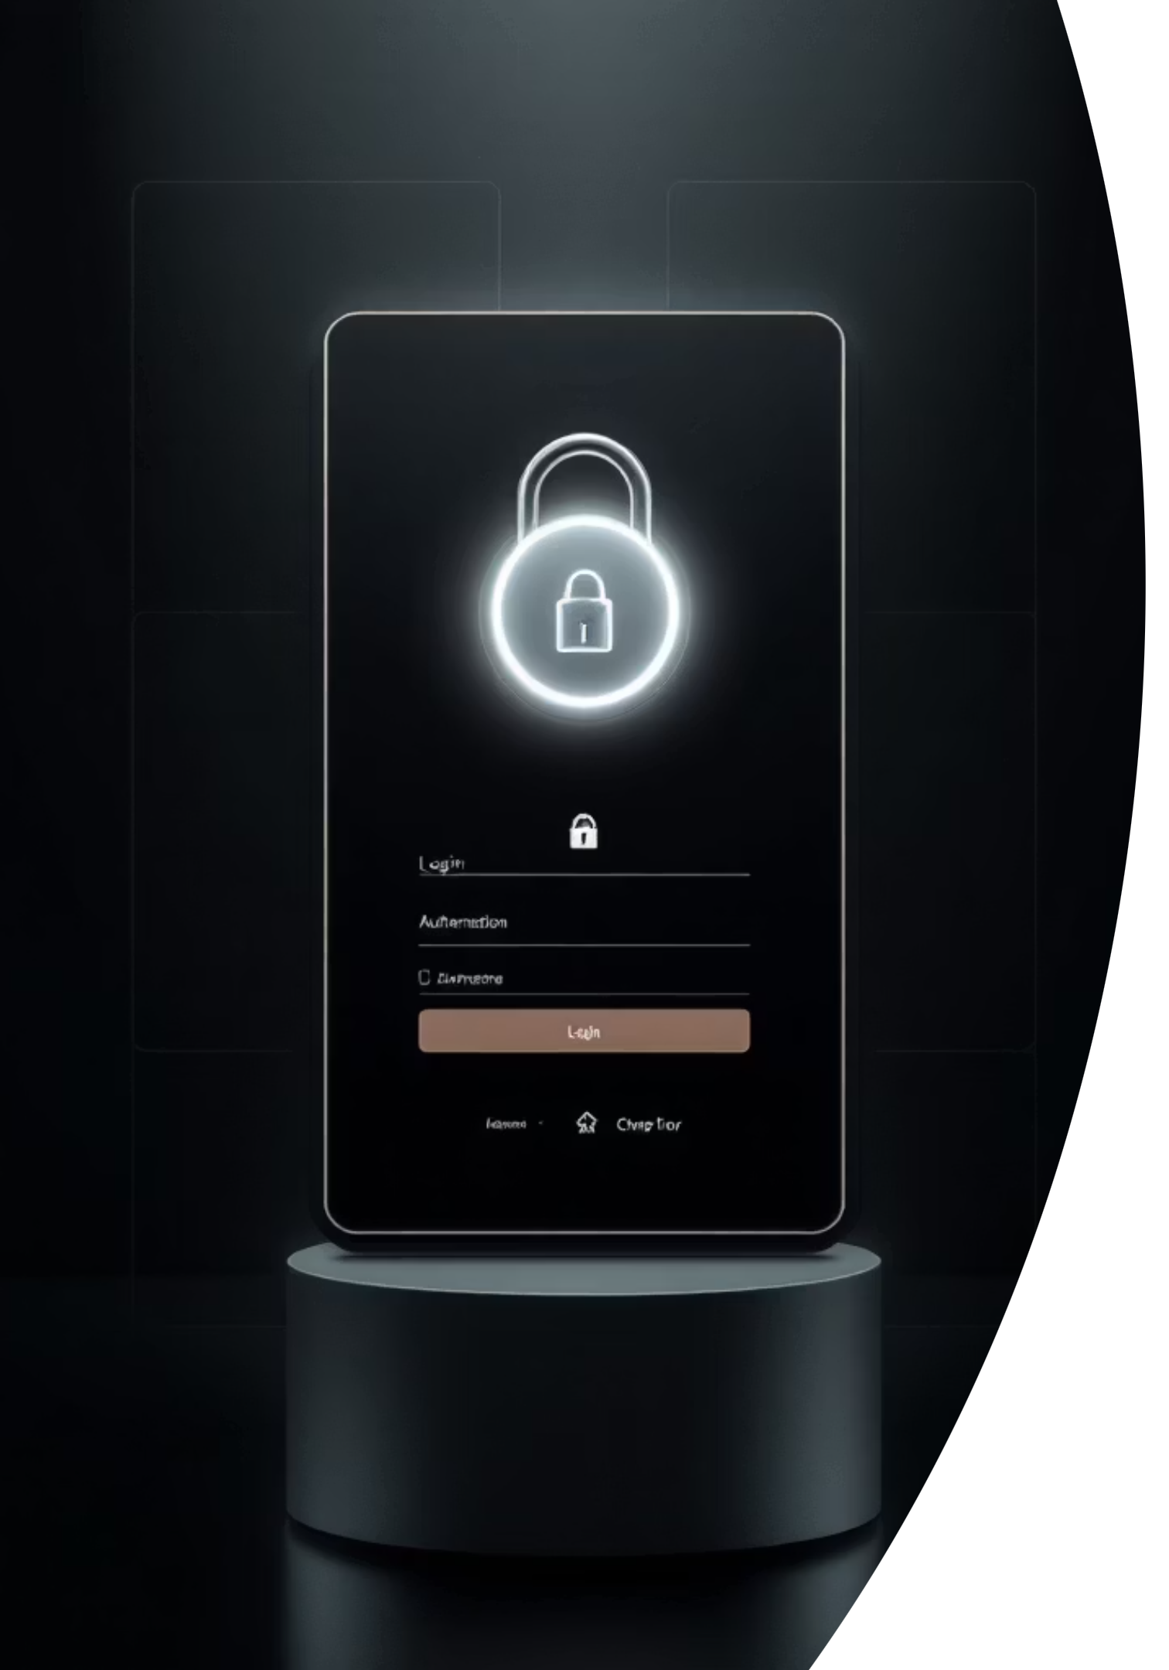
User Authentication Module
Security Features
Key Benefits
Encrypted password storage
Role-based access control
Session management
Secure API endpoints
Ensures only authorized personnel can access sensitive inventory data while maintaining audit trails of all user activities

Slide 15
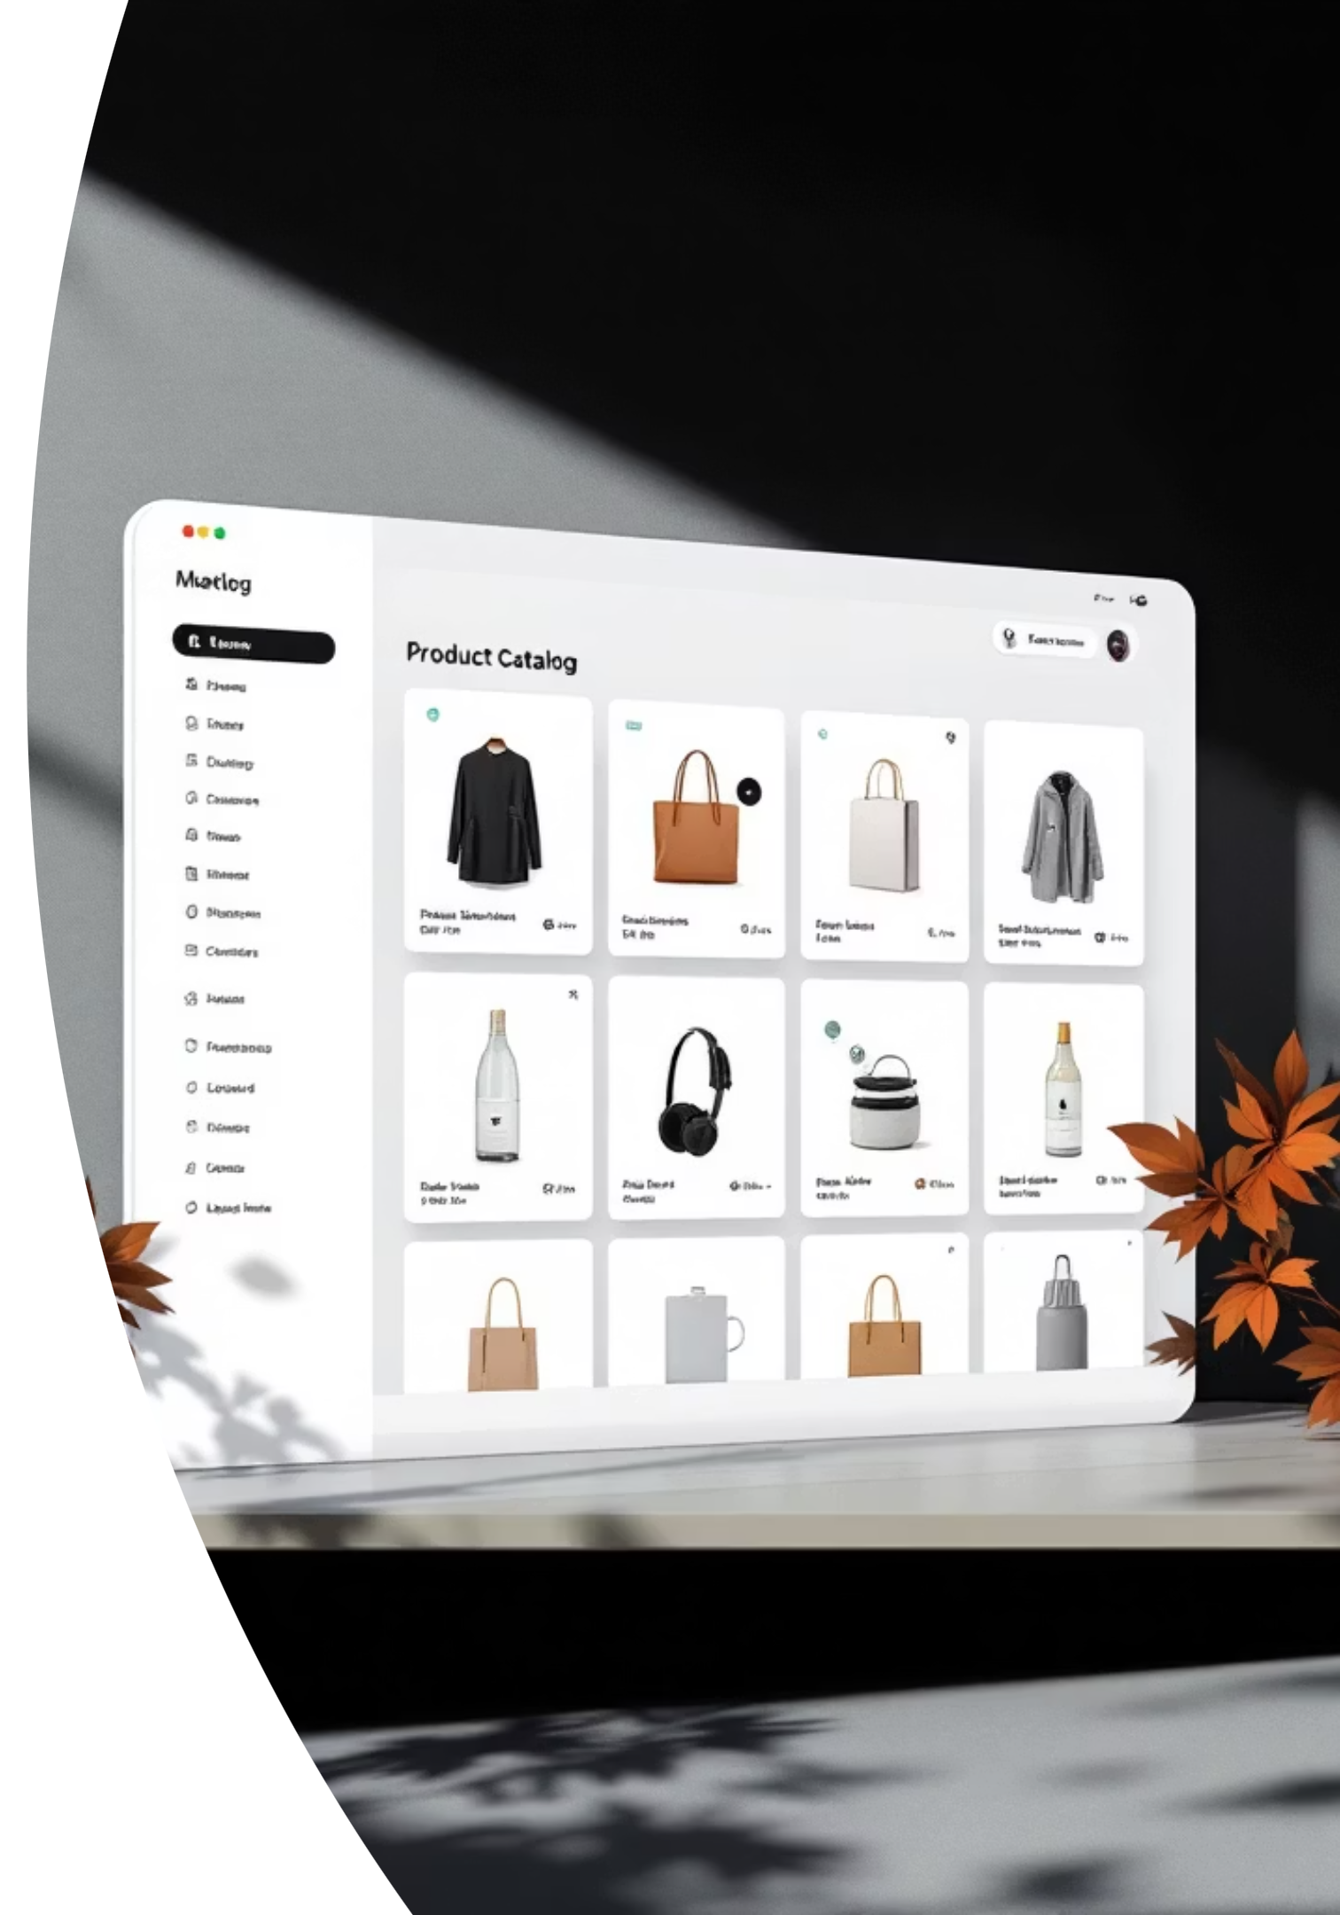
Product Management Module
Add Products
Register new inventory items with complete details including SKU, name, category, and pricing
Update Details
Modify product information, adjust pricing, or update specifications as business needs change
Search & View
Quickly locate products and access complete records including current stock levels and storage locations
Delete Products
Remove discontinued items while maintaining historical transaction records

Slide 16

Stock Management Module
Core Responsibilities
Real-time tracking of available inventory quantities
Automatic stock updates during purchases and sales
Comprehensive stock-in and stock-out management
Data validation to prevent inventory mismatches
Low-stock alerts to prevent running out of critical items
Maintains accurate, up-to-the-minute inventory counts across all locations

Slide 17




Storage Management Module
Location Setup
Define warehouse sections, aisles, and storage zones
Product Placement
Assign specific locations to each inventory item
Quick Retrieval
Guide staff to exact storage positions instantly
Optimizes warehouse space utilization and reduces product search time, improving operational efficiency

Slide 18





Database Design
A well-structured relational database ensures data integrity, consistency, and efficient querying
Products
Users
Complete inventory catalog with attributes
Authentication credentials and access permissions
Categories
Product classification system
Storage
Stock
Physical location mapping and organization
Quantity tracking and movement history

Slide 19
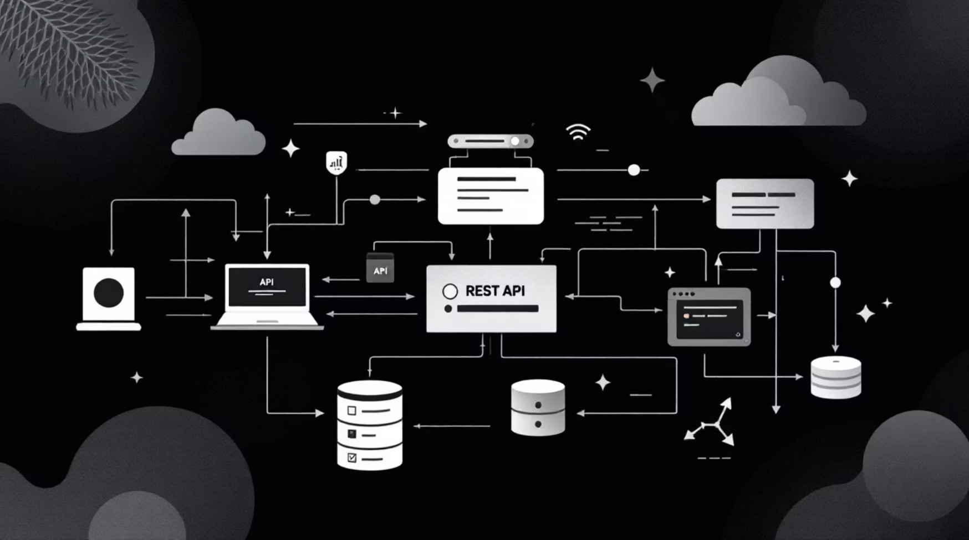
API Integration
RESTful Communication
GET
The React frontend communicates with the Spring Boot backend through standardized HTTP REST APIs, enabling seamless data exchange
Retrieve product lists, stock levels, and user data
POST
Create new products, users, and inventory records
PUT
Update existing product details and attributes
DELETE
Remove products and archive records

Slide 20
Key Features
A complete inventory solution designed for real-world business needs
User-Friendly Interface
Full CRUD Operations
Intuitive design that requires minimal training
Create, read, update, and delete inventory data
Real-Time Tracking
Secure Authentication
Instant stock updates across all transactions
Protected access with role-based permissions
Storage Management
Quick Data Access
Optimized warehouse organization
Fast searches and instant updates

Slide 21
Why Businesses Choose Our Inventory System
Modern inventory management software transforms how businesses track stock, process orders, and forecast demand. From small retail shops to large distribution centers, automated systems deliver measurable improvements in accuracy, speed, and decision-making.
Time Savings
Accuracy
Automated tracking and data entry eliminate manual processes, freeing staff for higher-value work.
Barcode scanning and digital records reduce human errors in inventory counts and order processing.
Real-Time Insights
Stock Control
Live dashboards and reports provide instant visibility into stock levels, sales trends, and reorder points.
Smart alerts prevent overstock situations and stockouts, optimizing working capital and customer satisfaction.
Automated Reports
Security
Schedule daily, weekly, or monthly reports delivered as CSV or PDF files—no manual data extraction needed.
Role-based access control and user authentication protect sensitive inventory data from unauthorized changes.
Scalability
Integration
Cloud-based architecture grows with your business, supporting additional locations, users, and integrations.
API connections to POS systems, e-commerce platforms, accounting software, and shipping carriers.

Slide 22

Development Challenges & Solutions
Building an integrated inventory system requires addressing several technical complexities. Our development approach systematically tackles each challenge to ensure a stable, scalable foundation.
System Integration
API Architecture
Successfully bridged React frontend with Spring Boot backend using Axios for HTTP requests and WebSockets for real-time updates
Designed RESTful endpoints following industry standards with clear request/response patterns and versioning support
Data Relationships
Validation Layer
Managed complex database schema with entity relationships, foreign key constraints, and optimized query performance
Implemented comprehensive error handling with client-side validation, server-side sanitization, and meaningful error messages

Slide 23

Future Roadmap
Our product vision extends beyond the current implementation. These upcoming features will significantly enhance functionality and user experience.
Barcode Scanning
Streamline inventory tracking with quick scans using mobile devices or dedicated hardware scanners
Analytics Dashboard
Visualize trends with real-time graphs, reports, and KPI tracking for data-driven decision making
Cloud Deployment
Scale infrastructure for enterprise needs with containerization, auto-scaling, and high availability
Mobile Version
Access inventory from anywhere, any device with responsive design and offline capability support

Slide 24

Project Success
Key Achievements
Complete digitization of inventory processes
Enhanced operational efficiency
Reduced manual errors
Reliable product tracking
Modern Tech Stack
Scalable Design
Production Ready
React for responsive UI with component-based architecture, Spring Boot for robust backend with dependency injection and security features
Built for growth with modular architecture, state management with Redux, and RESTful API design principles
Suitable for real-world business applications with comprehensive testing, CI/CD pipeline, and monitoring capabilities

Slide 25

Thank You
Questions & Discussion

